Slide 1
STUDENT NURSE SKILLS FOR SUCCESS
Presented by: Martin Ponciano, LVN, DSD, MS

Slide 2
LEARNING IS ...
The act or process of acquiring knowledge and/or skill in a particular subject.
A life-long process.

Slide 3
THE KEY TO SUCCESS
Success depends not on how you are taught but on how you choose to learn.
In order to effect change in your behavior, you need a positive attitude about learning.

Slide 4
ATTITUDE IS ...
A manner, feeling, or position toward a person or thing.

Slide 5
STRATEGIES FOR BUILDING A POSITIVE ATTITUDE
Create positive self-images.
Visualize the attainment of goals.
Recognize your abilities.
Identify realistic expectations.

Slide 6
SOME CONFIDENCE BUILDERS
Recognizing your abilities (competencies in various activities) is an attitude builder.
Avoid perfectionism. Perfection is a standard no one can live up to, and it sets you up for failure.
Develop your basic skills.

Slide 7
THE BASIC SKILLS
Reading
Arithmetic & Mathematics
Writing
Listening
Speaking

Slide 8
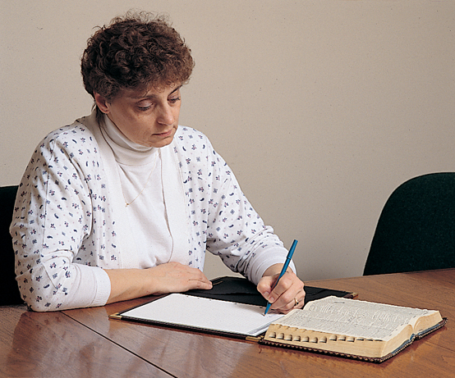
READING SKILLS
Vocabulary building
Comprehension
Achieving appropriate reading level

Slide 9
ARITHMETIC & MATHEMATICAL SKILLS
In nursing, your mastery of mathematical basic skills cannot be overemphasized.
You will be responsible for calculating dosages and administering medications.

Slide 10
WRITING SKILLS
As a nurse you will write:
Client assessments.
Transfer and discharge summaries.
Client-teaching plans.
Potential policy development.
Potential contributions to professional journals.

Slide 11
LISTENING SKILLS
Be interested in your subject.
Be open to the information.
Try not to be critical of the speaker.
Concentrate on the information.
Evaluate the information.
Write down questions as you listen.

Slide 12
SPEAKING SKILLS
Nursing is a speaking-oriented profession.
Understand why you are asking the question.
Know when to ask the question.

Slide 13
LEARNING STRATEGIES
Know your learning style.
Manage your time.
Develop a study strategy.
Practice critical thinking.

Slide 14
YOUR LEARNING STYLE
A learning style is how you best receive, process, and assimilate information on a particular subject.

Slide 15
CLASSIFICATION OF LEARNING STYLES
Visual…learner thinks in pictures.
Auditory…learner learns best by hearing and listening.
Kinesthetic…learner learns by touch, movement, imitation, and practice.

Slide 16
STRATEGIES FOR TIME MANAGEMENT
Analyze your time commitments.
Know yourself.
Clarify your goals.
Set priorities.
Discipline yourself to carry out your plan until your goal is reached.

Slide 17
DEVELOP A STUDY STRATEGY
Set up the environment.
Gather your resources.
Minimize interruptions.
Get to know the textbook.
Set up your study plan.
Take notes.

Slide 18
PREPARE FOR EXAMS
Review: recall information through a series of exercises to increase comprehension and facilitate application.
Decide which fact or groups of principles you have learned will be the basis for most nursing examination questions.

Slide 19
CRITICAL THINKING
The disciplined intellectual process of applying skillful reasoning, imposing intellectual standards, and self-reflective thinking as a guide to a belief or an action.
Notes:
I moved these two items to the beginning of "Critical Thinking" and added a slide to accommodate the next two bulleted items.

Slide 20
CRITICAL THINKING (continued)
Includes reading, listening, writing, and speaking.
Facts alone do not constitute a sufficient knowledge base for making sound decisions about client care.

Slide 21
CRITICAL THINKING (continued)
To decide which actions you need to take in a new situation, consider past experience, principles of care, and possible outcomes from a variety of interventions, and seek additional information.

Slide 22
STANDARDS FOR CRITICAL THINKING
Clarity–placing facts and ideas in a logical and coherent framework.
Precision–making sure that there is enough detail and specificity for a concept to be clearly understood.

Slide 23
STANDARDS FOR CRITICAL THINKING (continued)
Accuracy–being correct or true and within the proper parameters, and can be readily understood.
Relevance–refers to information connected to the issue as opposed to information that is not.

Slide 24
STANDARDS FOR CRITICAL THINKING (continued)
Consistency–the appropriate use of principles and concepts.
Depth–having an understanding that goes beyond the superficial.

Slide 25
STANDARDS FOR CRITICAL THINKING (continued)
Breadth–considering another point of view and asking if there is another way to look at the question or problem.
Fairness–the ability to identify the biases in your thinking and the biases present in the thinking of others.
Notes:
This slide added.

Slide 26
REASONING AND PROBLEM-SOLVING
Figuring things out; solving problems.
Includes several components.

Slide 27
PURPOSE
All reasoning is directed toward some specific purpose.
Nursing students reason to effectively solve client care problems.

Slide 28
THE QUESTION AT ISSUE
Must be clearly stated.
Good clinical judgment begins with a clear statement of problems presented by each client.

Slide 29
ASSUMPTIONS
Those things or ideas that are taken for granted
Accepted as being true without examination

Slide 30
POINT OF VIEW
Influenced by previous experience, available information, the quality of thinking already acquired, and many other factors.
Each person sees things differently.

Slide 31
DATA AND INFORMATION
The basic materials of reasoning.
Be sure that all information and data is clear, accurate, and relevant to the question or problem at issue.

Slide 32
CONCEPTS
Identify concepts needed to explore the problem and the implications of each.
The concepts important to nursing care must be part of the evidence supporting a nursing judgment.

Slide 33
INFERENCES AND CONCLUSIONS
Interpretation of data justified by the relevant facts
A logical answer to the question that began the process

Slide 34
IMPLICATIONS AND CONSEQUENCES
Reasoning usually produces more than one solution.
Think about how easily a solution can be applied, the ability of a person to carry out the required actions, risks involved, and negative and positive consequences.

Slide 35
CRITICAL THINKING AND THE NURSING PROCESS
Applies the problem-solving process to the practice of nursing and requires critical thinking.
Consistent attention to improving the quality of thinking will produce the traits of an educated person.

Slide 36
DEVELOP YOUR TEST-TAKING SKILLS
Analyze your attitude and expectations.
Concentrate on preparation.
Minimize anxiety.

Slide 37
IMPROVE YOUR TEST-TAKING SKILLS
Read carefully.
Know the vocabulary.
Do not infer additional data.
Identify priorities correctly.
Know the material!

Slide 38
TESTING ROOM TIPS
Get a good seat.
Set the mood.
Read…do not scan!
Consider questions carefully.
Do not argue with the question.
Plan your time.
DO NOT PANIC!

Slide 39
ADDITIONAL SKILLS FOR SUCCESS
Scope of practice/competence
Tasks of the UAP
Delegation
Prioritizing care
The nursing team

Slide 40
SCOPE OF PRACTICE/COMPETENCE
LP/VNs are dependent practitioners.
Tasks and responsibilities within the scope of practice may be beyond an individual’s scope of competence.
Scope of competence expands as new skills within scope of practice are learned.
This varies from state to state.

Slide 41
TASKS OF THE UAP
Unlicensed Assistive Personnel
May perform only those health-related activities for which they have been determined competent to perform.

Slide 42
DELEGATION
The process of transferring to a competent individual the authority to perform a select task in a select situation.
This varies from state to state.

Slide 43
FIVE RIGHTS OF DELEGATION
Right Task
Right Circumstance
Right Person
Right Direction/Communication
Right Supervision

Slide 44
PRIORITIZING CARE
Requires an understanding of the importance of different problems to the nurse, the client, the family, and other health care providers.

Slide 45
FACTORS TO HELP ESTABLISH PRIORITIES
Safety
Timing
Interdependence of events
Client requests
Availability of help
Client’s status
Availability of resources

Slide 46
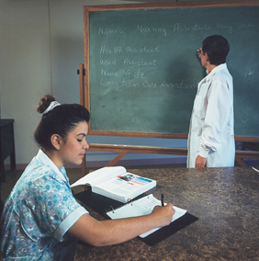
THE NURSING TEAM
Consists of UAPs, CNAs, LP/VNs, RNs, and NPs.
Roles, levels of education, skills vary.

Slide 47
FROM STUDENT TO LP/VN
The NCLEX-PN
All practical/vocational nurses must pass this examination in order to be licensed.
Your license
It is your responsibility to maintain your license according to your state’s standards.

